Slide 1


“The best guide to your future”
Arsela | Ebin | Kylene | Ronak | Shirley | Susan | Tarini

Slide 2
Contents
Executive Summary
Vision
Pain Points
Product Mockup
Pros and Cons
Action Plan

Slide 3

Home
Contents
Executive Summary
Vision
Pain Points
Product Mockup
Pros & Cons
Action Plan
Executive Summary
Facilitate life transition by creating a streamlined and integrated lifestyle transition platform.
Anticipate possible queries and concerns addressed with added services
Help people create a holistic road map for their future, have them coming back to the platform for the community.
Why is this needed?
Complex and decentralized job hunting process.
Greater emphasis on lifestyle-job balance.
CitiVentures Innovation Challenge

Slide 4


Home
Contents
Executive Summary
Vision
Pain Points
Product Mockup
Pros & Cons
Action Plan
Vision
One-stop information hub
Lifestyle transition platform
Active community
CitiVentures Innovation Challenge

Slide 5



Home
Contents
Executive Summary
Vision
Pain Points
Product Mockup
Pros & Cons
Action Plan
Pain Points
User Side
Company Side
City Side
CitiVentures Innovation Challenge

Slide 6
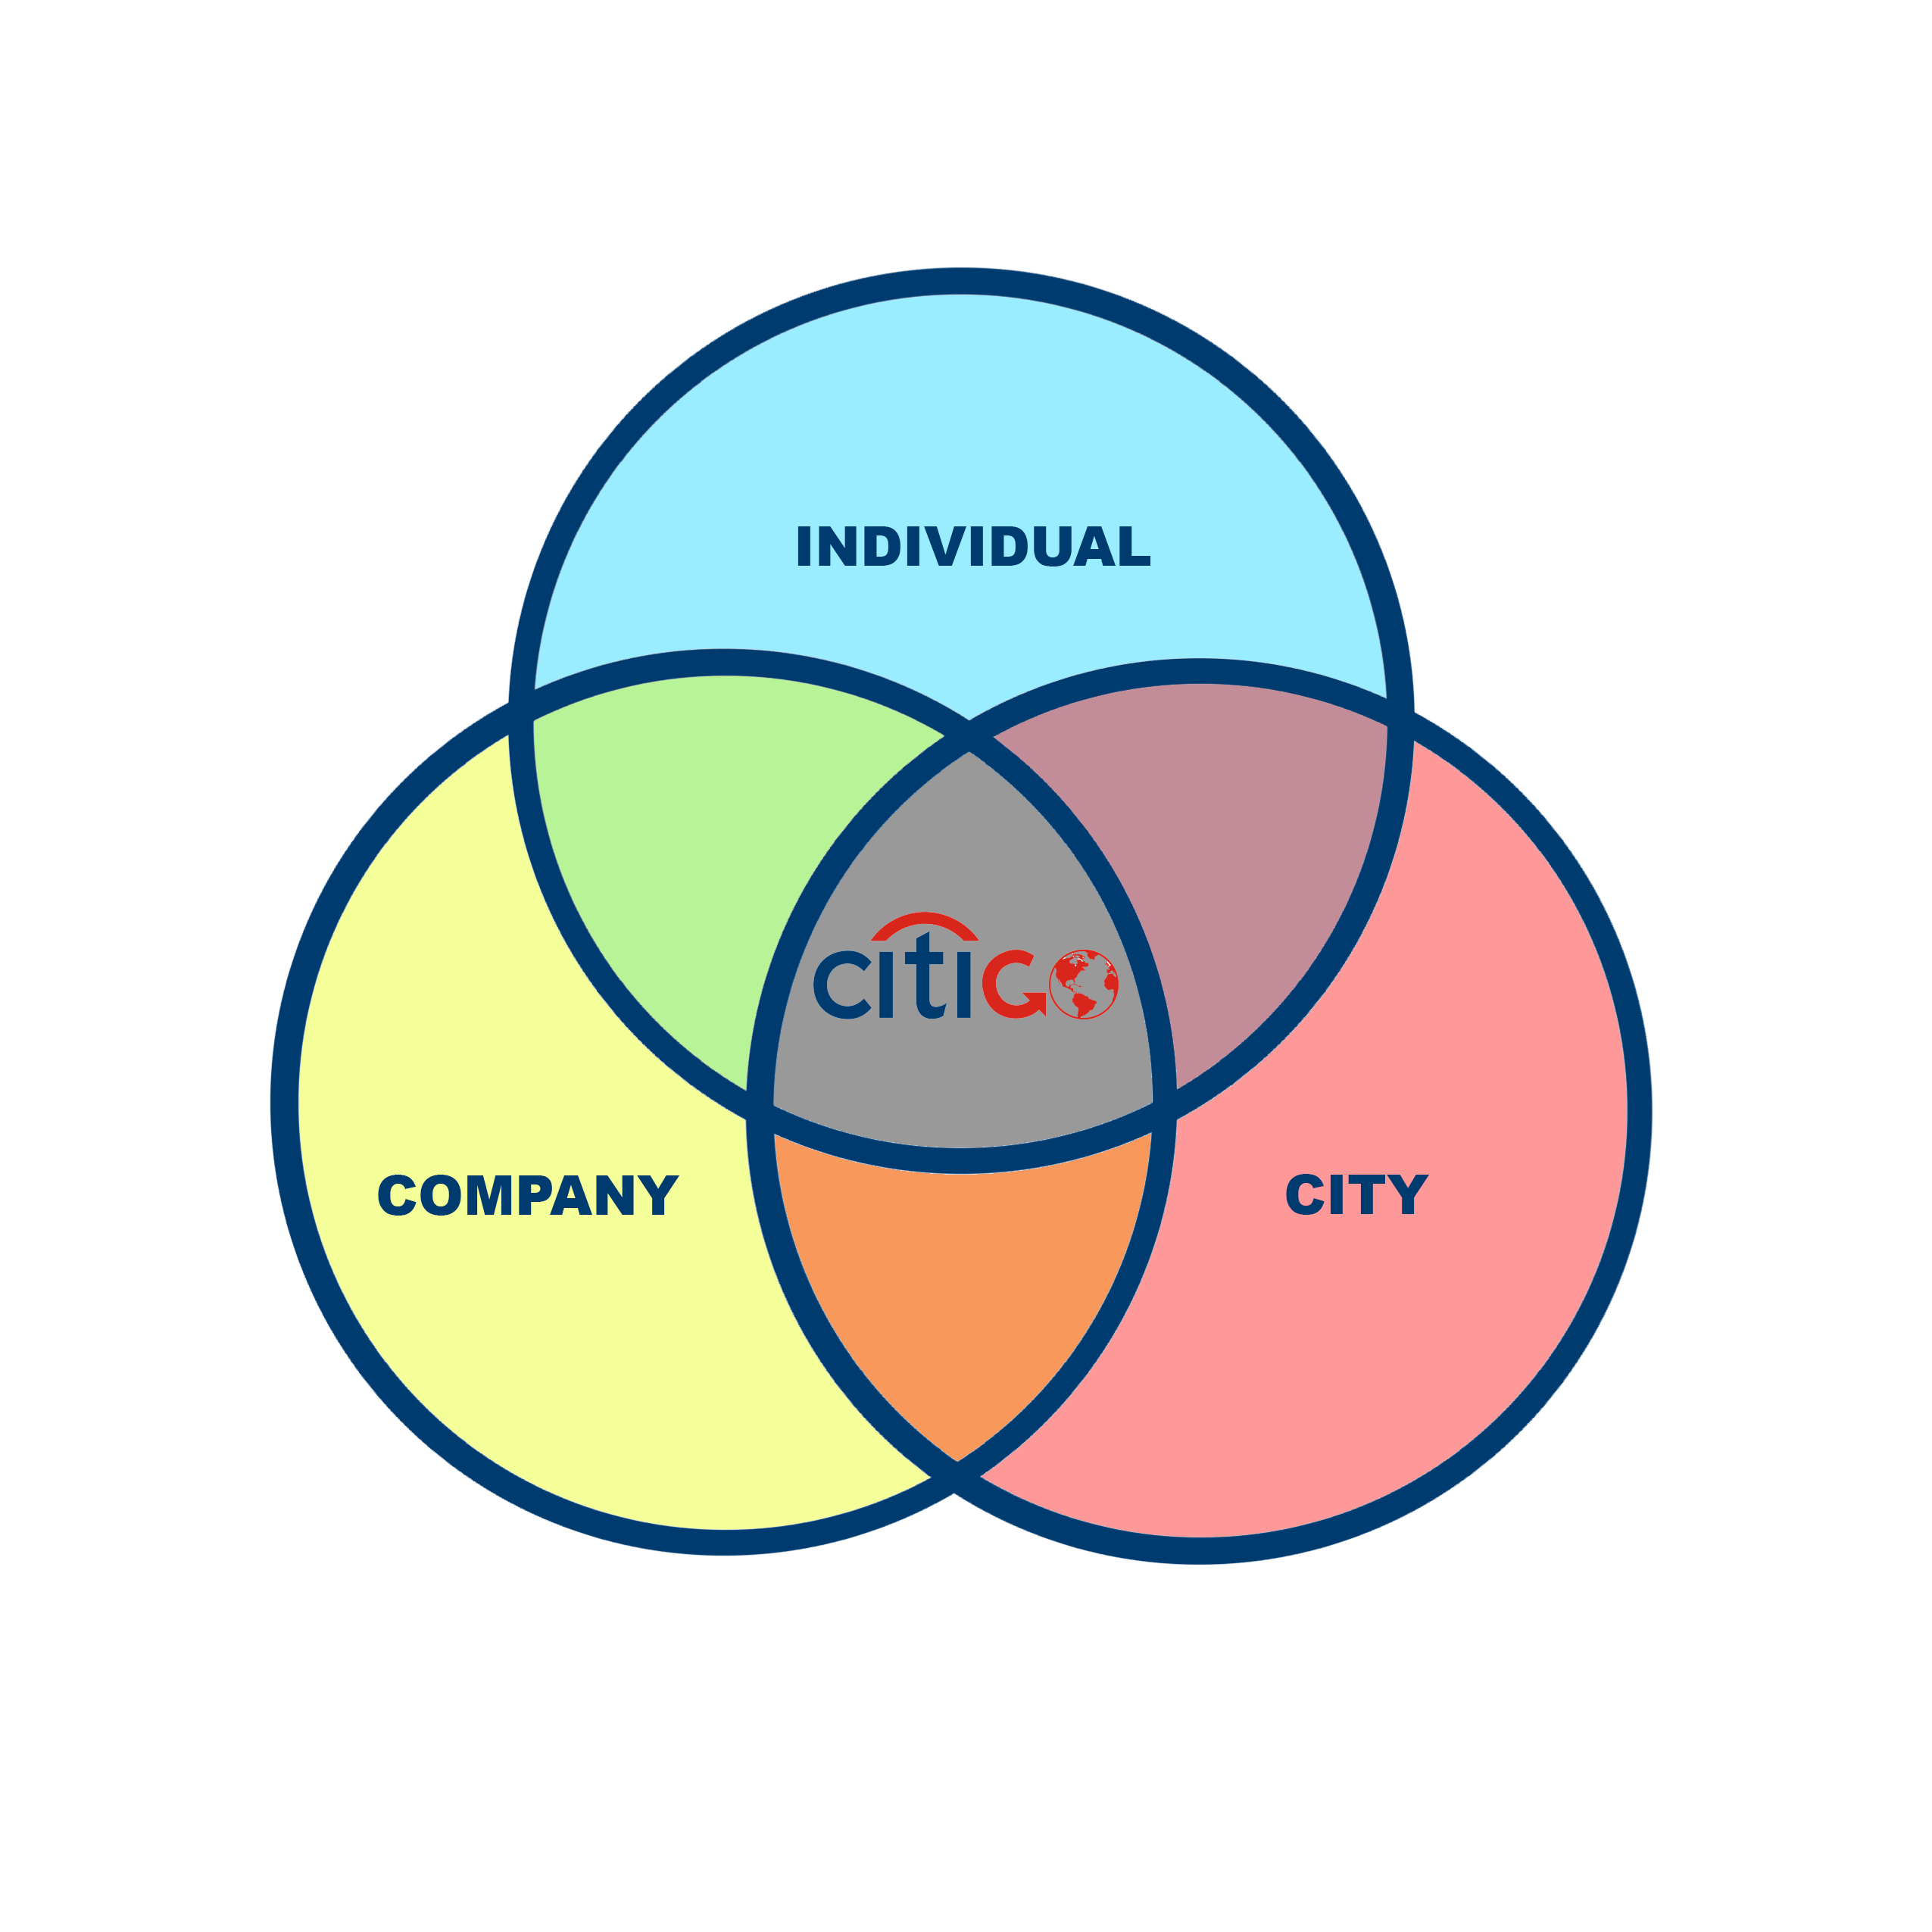
Home
Contents
Executive Summary
Vision
Pain Points
Product Mockup
Pros & Cons
Action Plan
Pain Points
CitiVentures Innovation Challenge

Slide 7
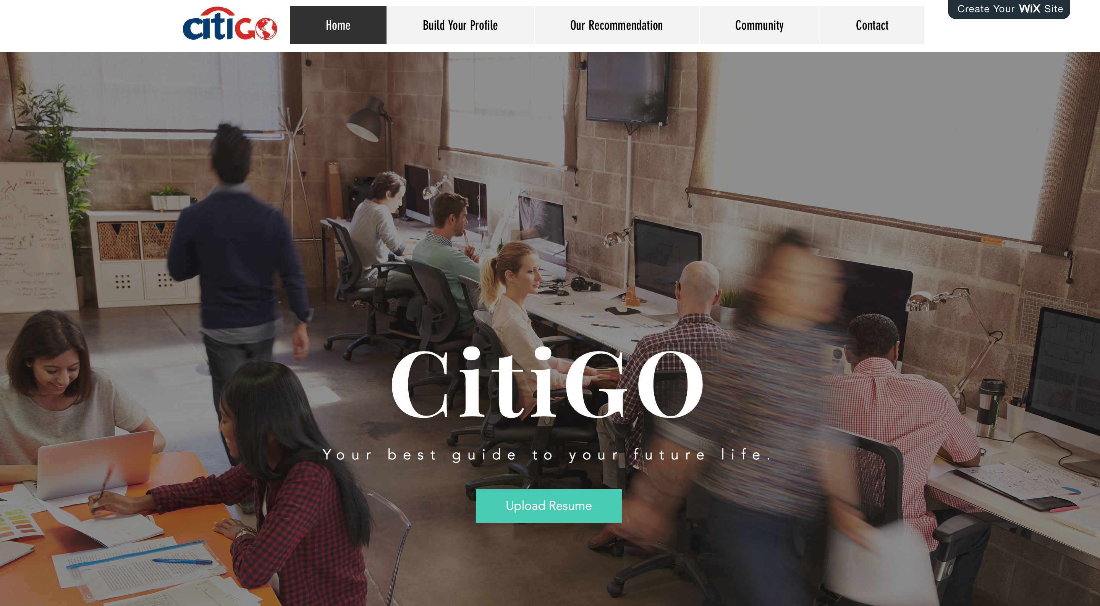
Home
Contents
Executive Summary
Vision
Pain Points
Product Mockup
Pros & Cons
Action Plan
Product Mockup
CitiVentures Innovation Challenge

Slide 8
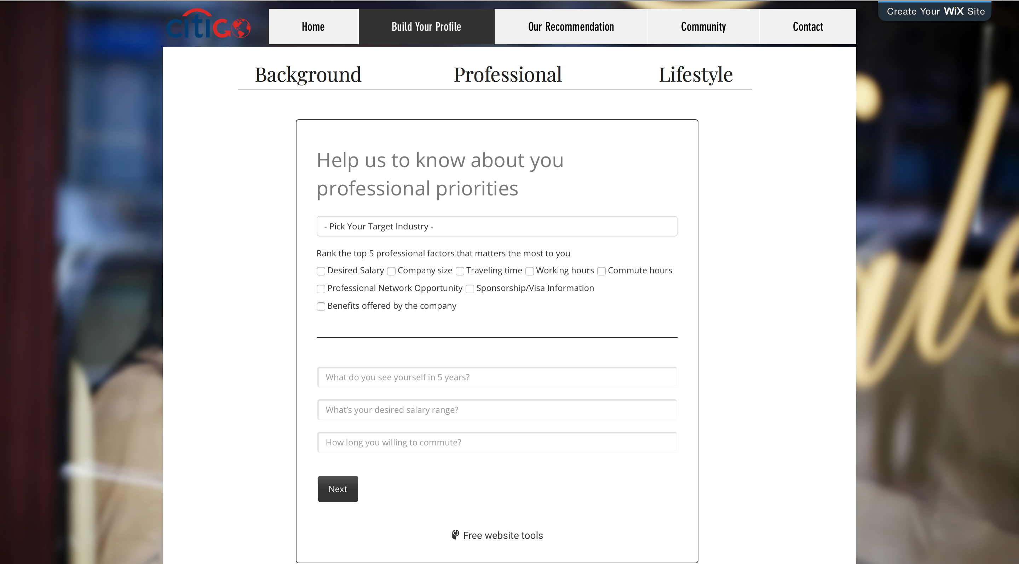
Home
Contents
Executive Summary
Vision
Pain Points
Product Mockup
Pros & Cons
Action Plan
Product Mockup
CitiVentures Innovation Challenge

Slide 9
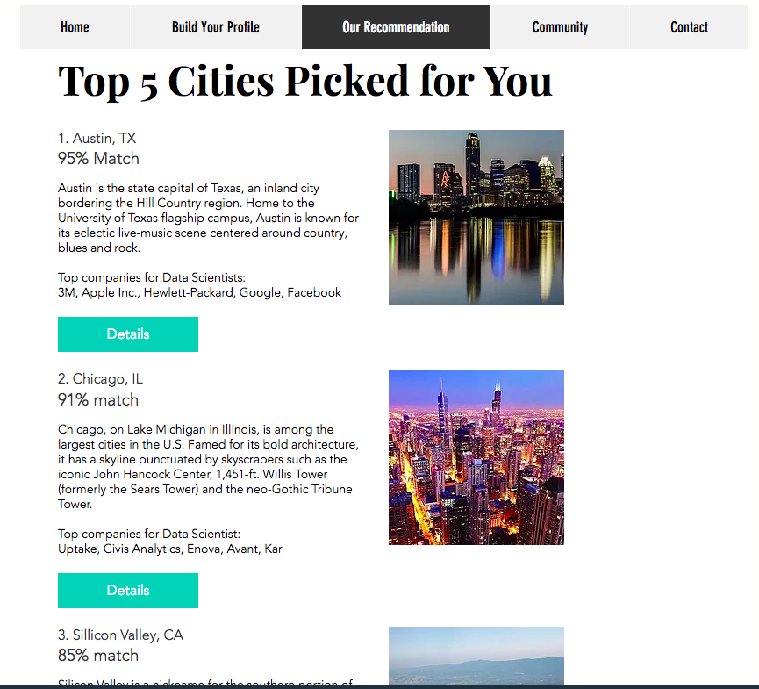
Home
Contents
Executive Summary
Vision
Pain Points
Product Mockup
Pros & Cons
Action Plan
Product Mockup
CitiVentures Innovation Challenge

Slide 10
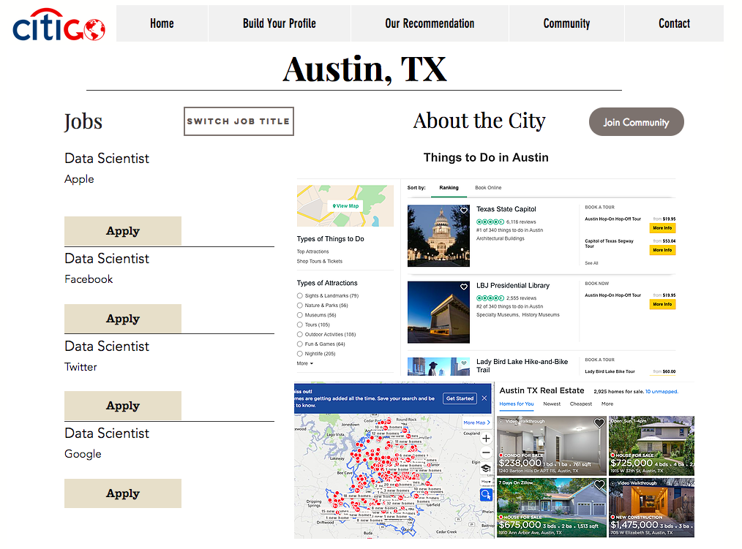
Home
Contents
Executive Summary
Vision
Pain Points
Product Mockup
Pros & Cons
Action Plan
Product Mockup
CitiVentures Innovation Challenge

Slide 11


Home
Contents
Executive Summary
Vision
Pain Points
Product Mockup
Pros & Cons
Action Plan
Pros & Cons
Advantages
More holistic system than current competitors
Real time update system
Potential for monetization
Spread of Citi brand name in consumer market
Valuable user data can be used to improve the system/further insights
People coming back because of community - long term sustainability
Long term social well being - better fit for users
Gaps
Data update and data quality challenges
High investment cost in technology - building algorithms & models
High maintenance cost and efforts
CitiVentures Innovation Challenge

Slide 12
Home
Contents
Executive Summary
Vision
Pain Points
Product Mockup
Pros & Cons
Action Plan
Action Plan
2018
CitiVentures Innovation Challenge

Slide 13
Home
Contents
Executive Summary
Vision
Pain Points
Product Mockup
Pros & Cons
Action Plan
Action Plan
2018
2022
- 1 to 1 chat with city experts
- Chat forums specific to each city
- Monetization processes
- Develop customer base & reputation
- Stabilize data structure, establish reliable data sources
- Scale the product
- Partnerships with companies, schools, city government etc.
- Offer future vision of the city for users/companies using VR/AR
2019
CitiVentures Innovation Challenge

Slide 14


